Slide 1





SYSTEM MODELLING AND DESIGN OF AN ARCHIVAL AND RETRIEVAL SYSTEM OF MISSING ITEMS
TASK 4
GROUP 6

Slide 2
TABLE OF CONTENTS
01
02
03
04
05
06
INTRODUCTION
CONTEXT DIAGRAM
USE CASE DIAGRAM
CLASS DIAGRAM
SEQUENCE DIAGRAM
DEPLOYMENT DIAGRAM

Slide 3

01
INTRODUCTION
This phase outlines the modelling and design of our system
The system aims at providing UI for reporting lost items , upload images and Searching for potential matches and receiving notifications
We will provide various uml diagrams that will help us in visualizing the system component, their relationship and the flow of operation within the system

Slide 4
02
CONTEXT DIAGRAM
A context diagram is a diagram that provides a high level overview of a system and how the system interacts with external entities and also processes the system

Slide 5
COMPONENTS OF A CONTEXT DIAGRAM
EXTERNAL ENTITIES
SYSTEM BOUNDARY
DATA FLOWS
Represents a single process or entity at the center of the diagram and clearly
Represents external actors that interact with the system
Arrows use to show the flow of information

Slide 6
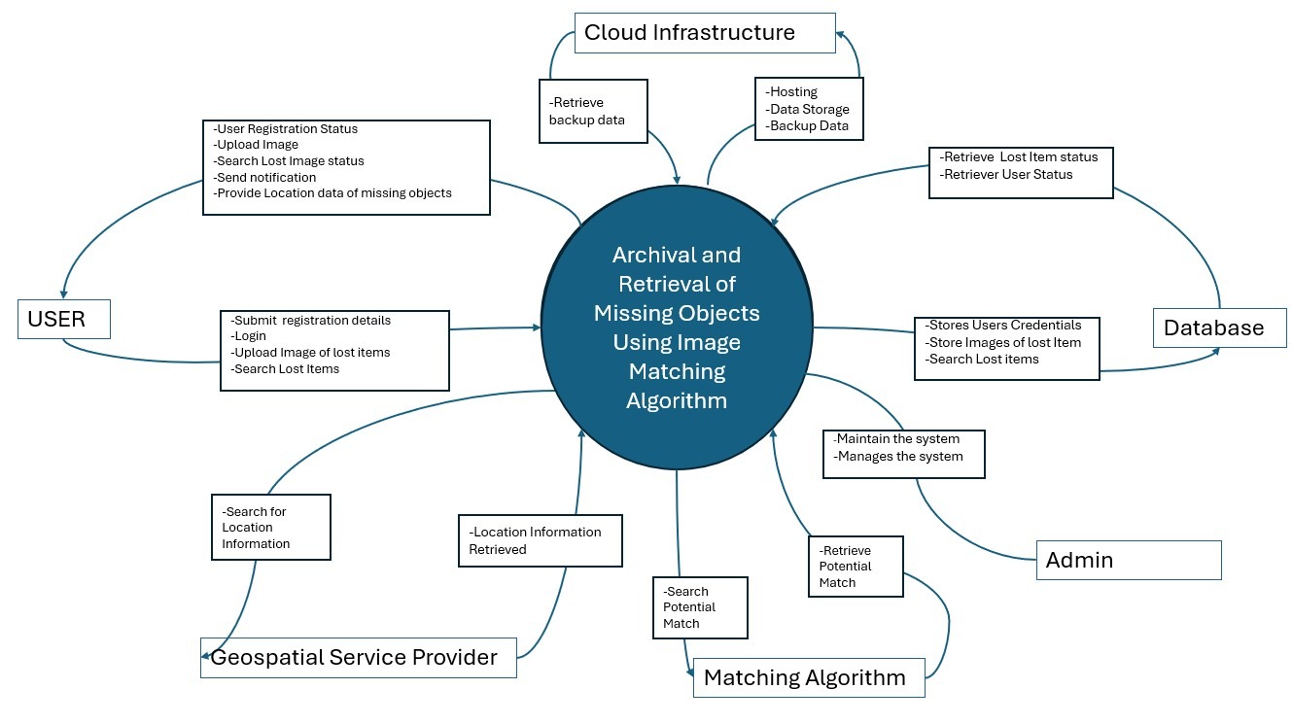
CONTEXT DIAGRAM

Slide 7
03
USE CASE DIAGRAM
It is a graphical representation of a user’s possible interaction with a system. A use case diagram shows various use cases and different type of users the system has and their relationship

Slide 8
COMPONENTS OF THE USE CASE DIAGRAM
END USER
Individuals that report their missing items,searching for items and other performance related actions
ADMIN
An individual responsible for performing administrative operations and overseeing the operations of the system
SYSTEM AND RELATIONSHIPS
The system refers to the overall software system that provides functionality for reporting a nd retrieving missing items while the relationship depicts the interaction between the actors and the system

Slide 9
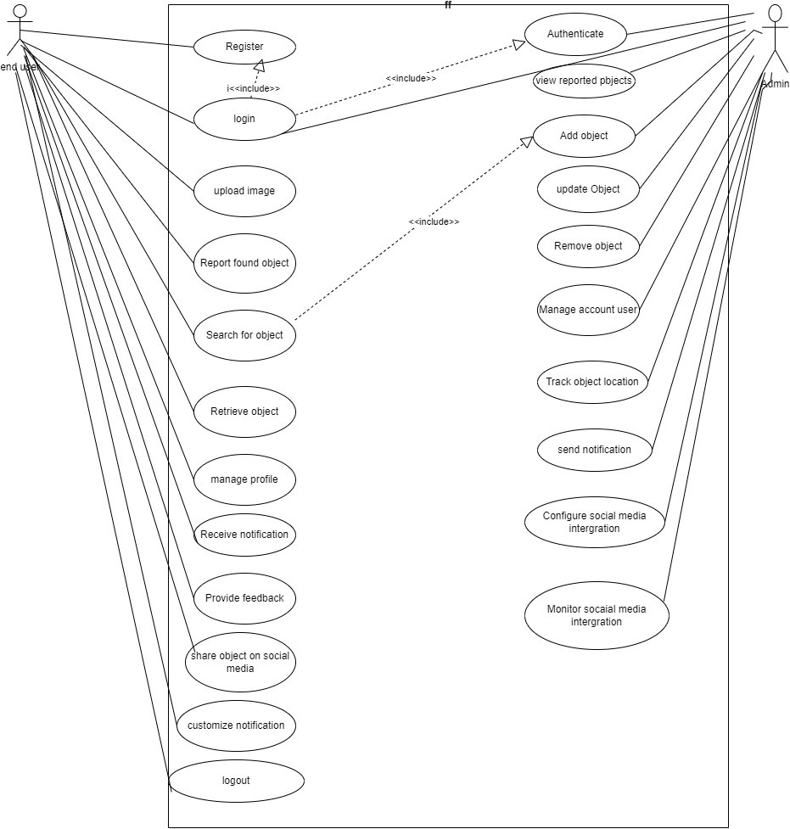
USE CASE DIAGRAM

Slide 10
04
CLASS DIAGRAM
It provides a high level overview of how different components of a system interacts with each other,it illustrates the structure of a system by showing it’s classes , attributes, operation and the relationship amongst them

Slide 11
CLASSES IN OUR SYSTEM
USER CLASS
IMAGE CLASS
Manages user related activities like registration, authentication etc
Represents images uploaded by the user
ADMIN CLASS
LOCATION CLASS
Provides location of the missing item
Manages the system and provides support
DATABASE CLASS
NOTIFICATION CLASS
Manages data storage and Retrieval
Represents notifications sent to the user

Slide 12
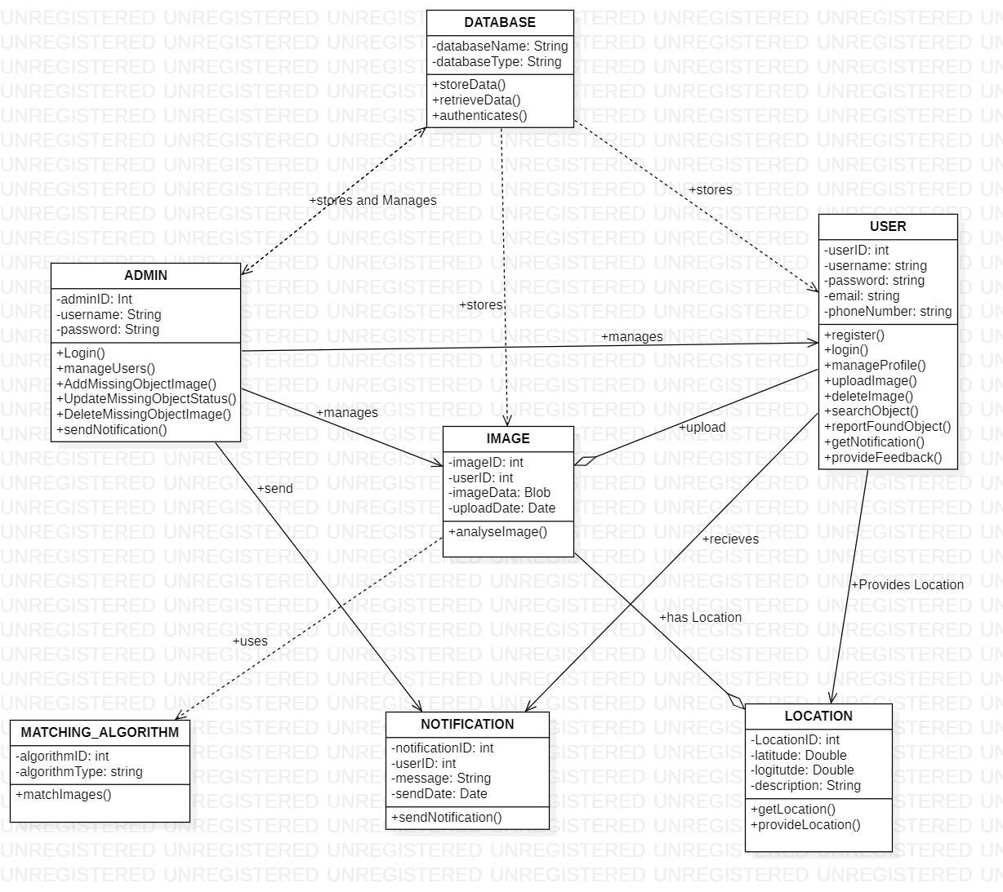
CLASS DIAGRAM

Slide 13
05
SEQUENCE DIAGRAM
It shows how the user interact with the system components during the archival and Retrieval of missing item
It shows the sequence of message exchange between objects to perform a specific function , providing a clear view of the interactions and the order in which they appear

Slide 14
COMPONENTS OF THE SEQUENCE DIAGRAM
ADMIN
USER
OBJECTS
Represents the person using the system to upload , report and search for missing objects
Represents the person that manages the system and users of the system

Slide 15
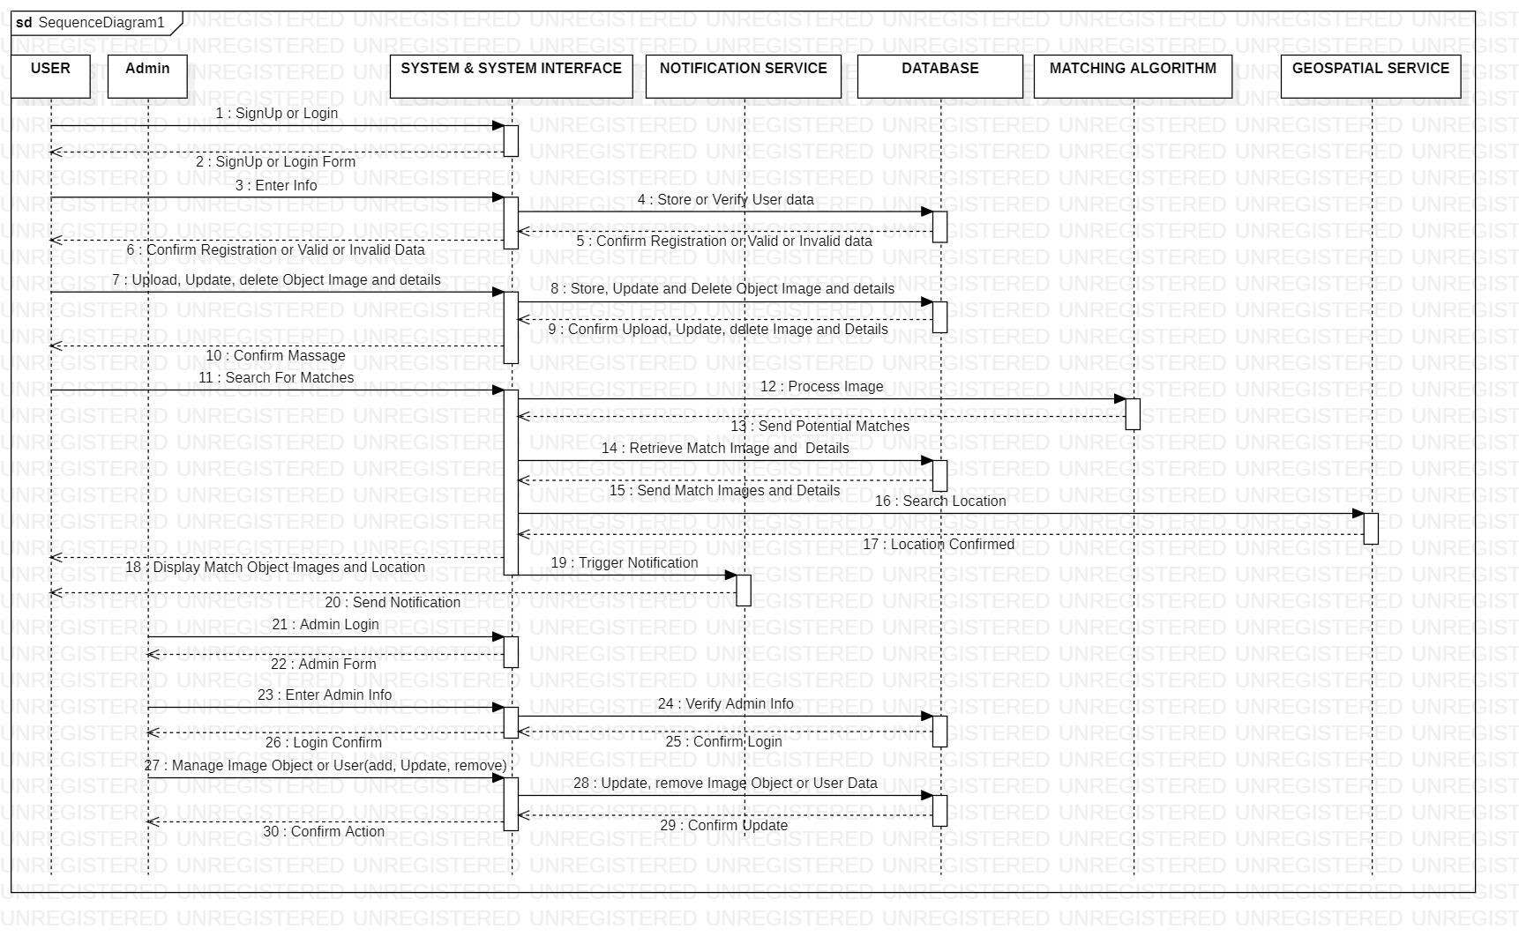
SEQUENCE DIAGRAM

Slide 16
06
DEPLOYMENT DIAGRAM
It shows how the physical system will look like when all is put together
It shows how artifacts are deployed on system hardware and how pieces of hardware connect with one another

Slide 17
COMPONENTS OF THE DEPLOYMENT DIAGRAM
NODES
A computational resource which artifacts are deployed for execution
ARTIFACTS
They are model elements that represent the physical entities in a software system
MODULES
A self contained unit of a software or hardware that can be deployed as a whole

Slide 18
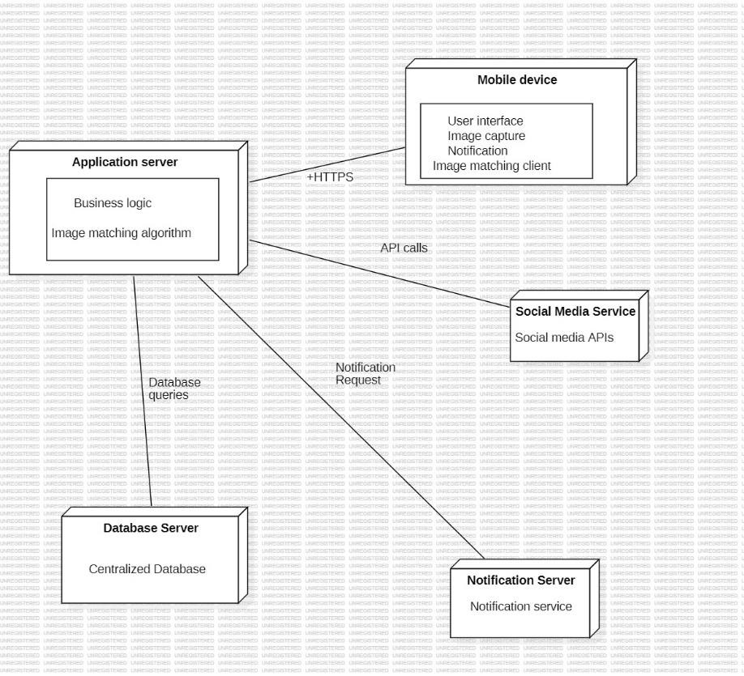
DEPLOYMENT DIAGRAM

Slide 19
CONCLUSION

Slide 20
THANKS!

